Slide 1

WELCOME TO OUR TRANSPORT COMPANY
OWNED BY-
MR. PUKHRAJ LOL TCG PHQ JAIPUR
(project manager)
MR. BALDEV RAM TCG PHQ JAIPUR

Slide 2
MOST CONVENIENT & RELIABLE TRANSPORT SERVICES FOR YOURS
OUR PRIORITY TO SERVE BETTER FOR YOU
Ensuring smooth and efficient operations to transport goods from one location to another safely and on time
Meeting or exceeding customer expectations by providing reliable, timely, and safe transportation services
Embracing innovative technologies and solutions to improve efficiency, enhance customer experience
Identifying and mitigating potential risks such as accidents, disruptions that could impact operations
The aim of a transport company is to provide reliable, safe, and efficient transportation services while maintaining profitability and contributing positively to society and the environment
FOLLOWING THREE LAYER OF APPLICATION WE DISCUSS LATER
ADMIN LAYER
REGIONAL MANAGER LAYER
USER LAYER

Slide 3
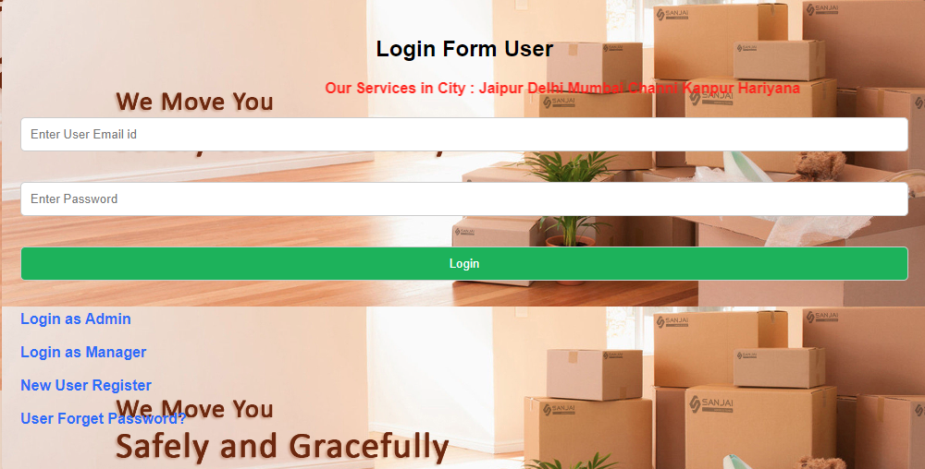
FIRST INTERFACE ON BROWSER AFTER LOADING

Slide 4
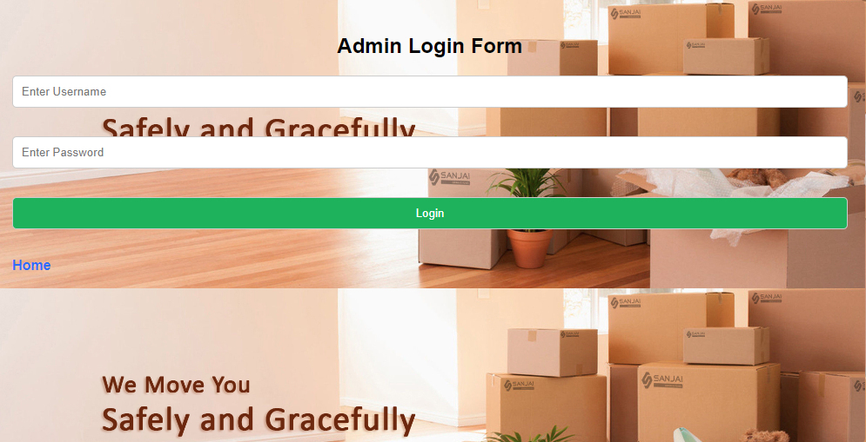
ADMIN LAYER
Admin Interface On Browser
>To do it admin login is required for admin username and password, kindly have a look of “web.xml” context-param tag. >Only one admin/owner have in this application org.apache.jasper.runtime.HttpJspBase
To do it admin login is required .for admin username and password, kindly have a look of “web.xml”

Slide 5
Following Authority For Admin -
Admin can see the all working manager in our company .
Admin can appoint new manager for the different regional offices.
Admin can terminate the manager from job.
Admin can re-edit the information of the manager such that salary ,mobile no. etc.
Admin can install the new vehicle in our company for desir route.
Admin can uninstall the vehicle .
Admin can see the all vehicle information including its route and running status such that running,accident,stay at etc.
The request came from user first at admin portal. Admin can accept the request or decline it.
Each action taken by the Admin on request reflect on the user portal and regional manager portal also.

Slide 6
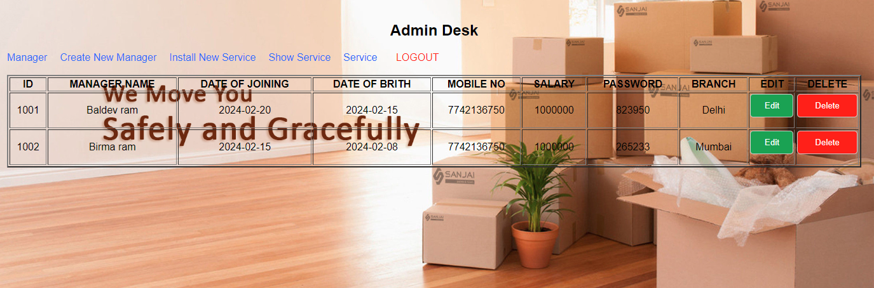
Admin can see the all working manager in our company
When press this the manager terminated

Slide 7
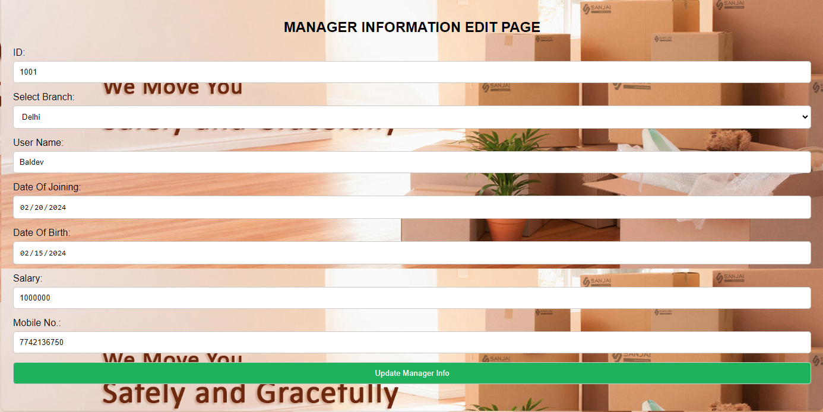
> When admin press the Edit Button in above slide table then below browser interface seen.
> Update Manager info button save the information in database.
> Here the Id ,Name,Date of Joining,Date of Birth can’t be change(Read Only) by the Admin

Slide 8
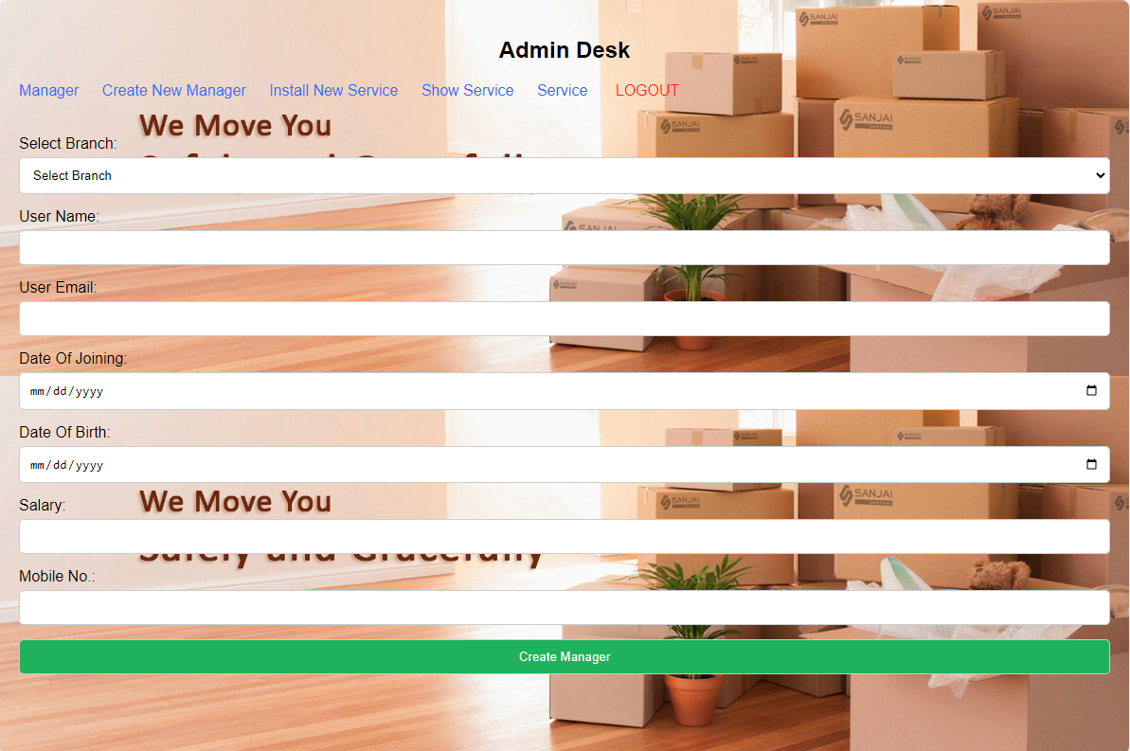
Admin can appoint new manager for the different regional offices
-when admin press the Create Manager link after filling all information then userId and password sent on the email id of manager . if same manger appoint again then popup generate on the page and appointment fail

Slide 9
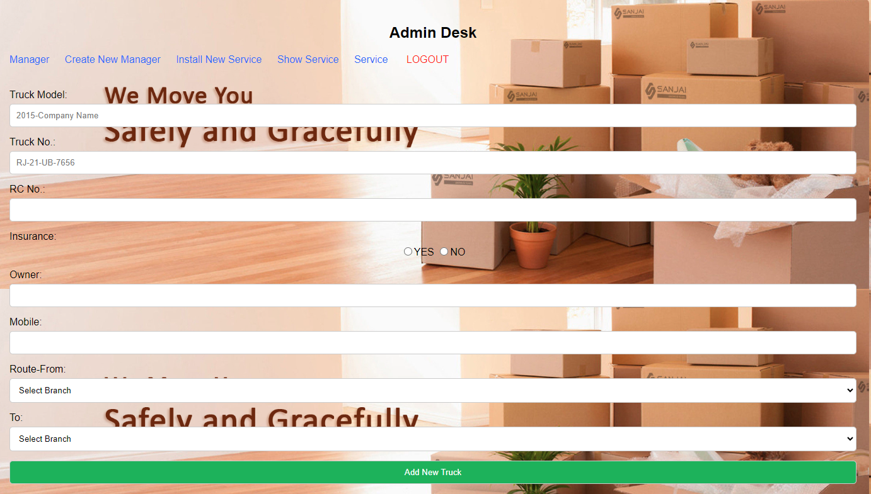
Admin can install the new vehicle in our company for desir route.
-when admin press the Install New Service link below interface appear after filling all information press Add New Truck . if same vehicle install again then popup generate on the page and installation fail otherwise information add successfully .

Slide 10
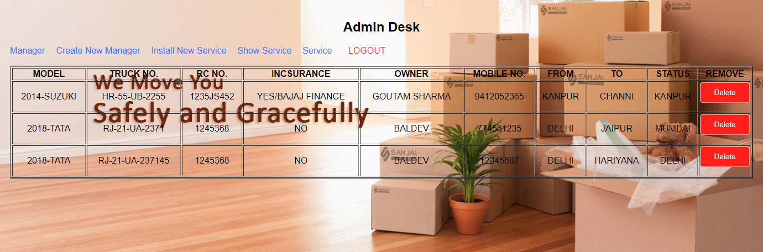
Admin can see the all vehicle information including its route and running status
-when admin press the Show Service link below interface appear .
When press this the vehicle remove

Slide 11
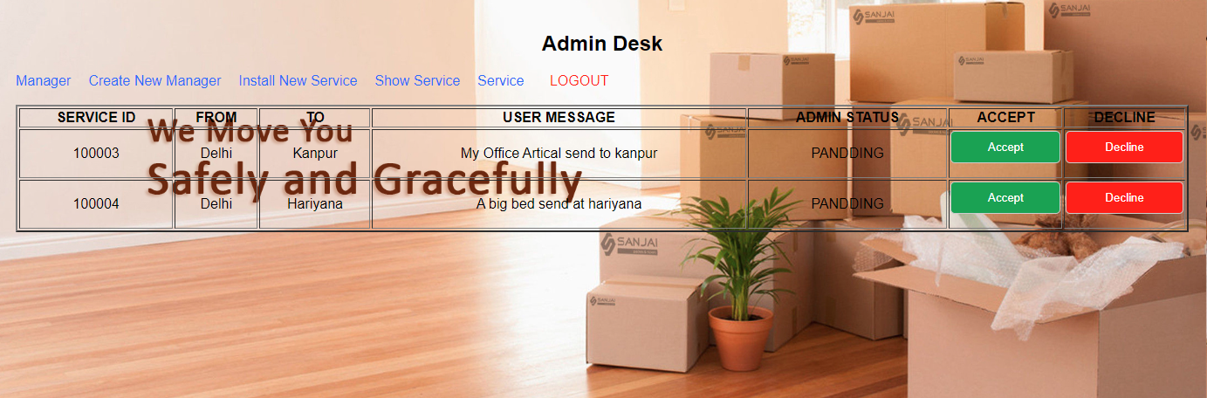
The all request came from user first at admin portal. Admin can accept the request or decline it
-when admin press the Service link below interface appear . Seen all the service request came from user.
-when admin Accept request then user status change PENDING to FORWARDED and request forward to regional manager .
-when admin Decline the request then a massage send on the email id as well as the request not forward to regional manager.
When Admin Press LOGOUT Link Home Page Seen

Slide 12
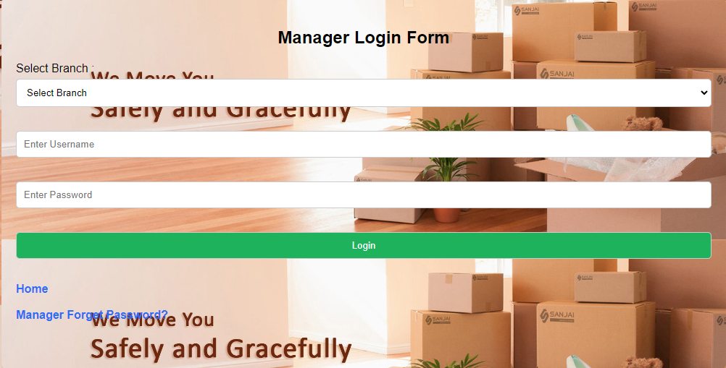
REGIONAL MANAGER LAYER
Manager Login Interface On Browser
>when click on Login as Manager Link of Home page then Manager Login Page is appear.
>To manager login Email and password, kindly have a look of Registered email .The password send by admin at the time of appointment Or manager can go through the Forget Password.

Slide 13
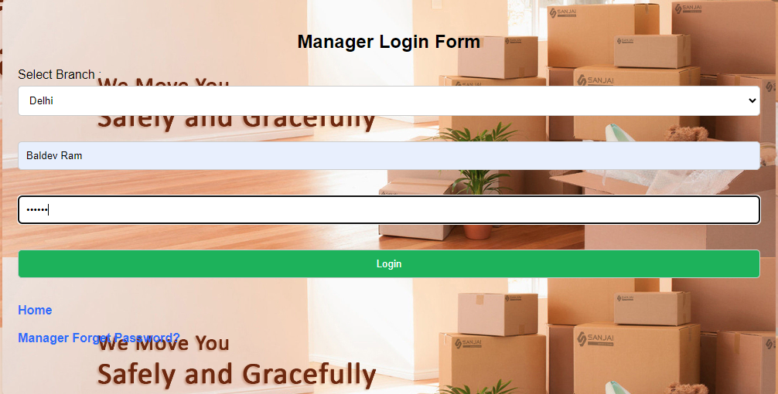
Manager login Interface
>When manger put our right input in below interface then login successfully in manager desk

Slide 14
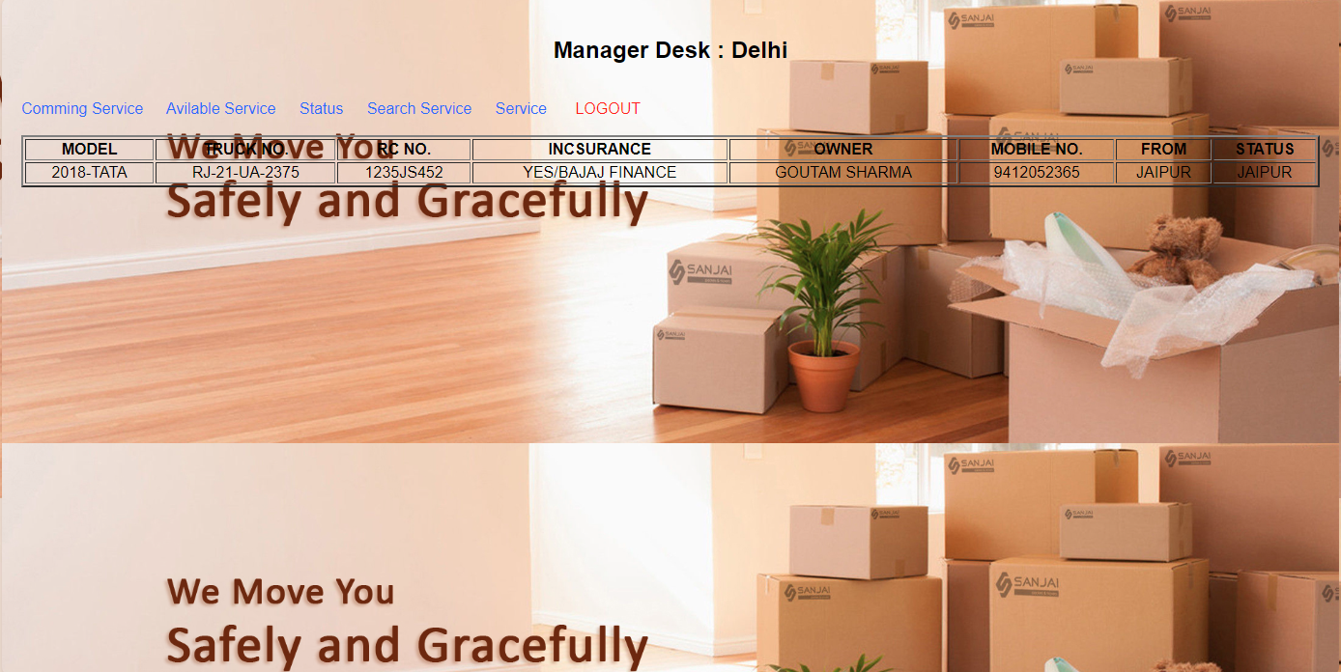
>When manager click on the Coming Service then it can seen the all services from our branch to another branch

Slide 15
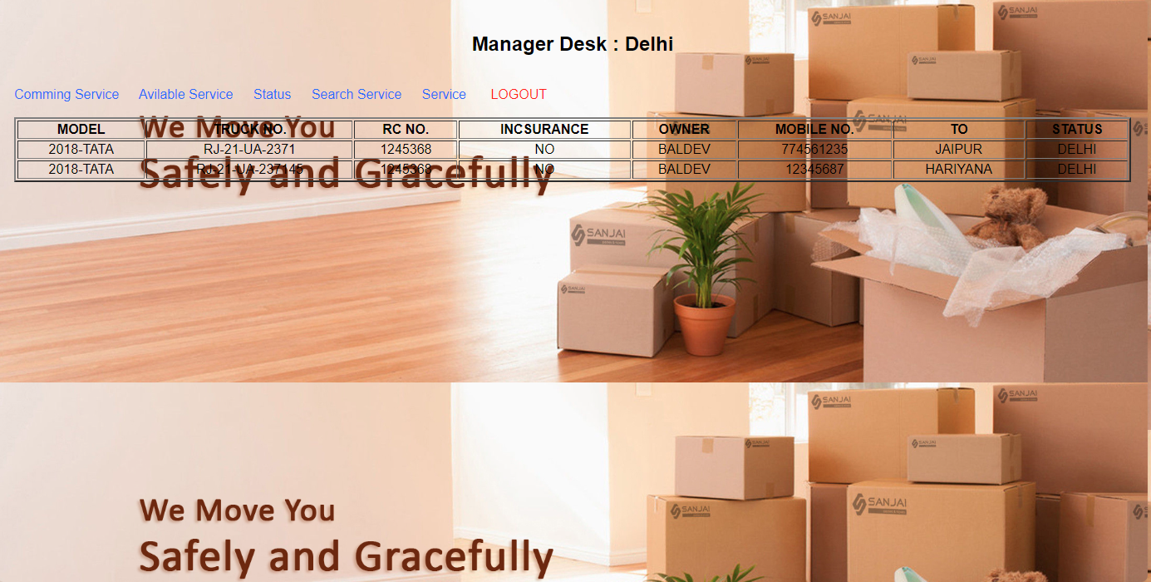
>When manager click on the Available Service then it can seen the all services from another branch to our branch

Slide 16
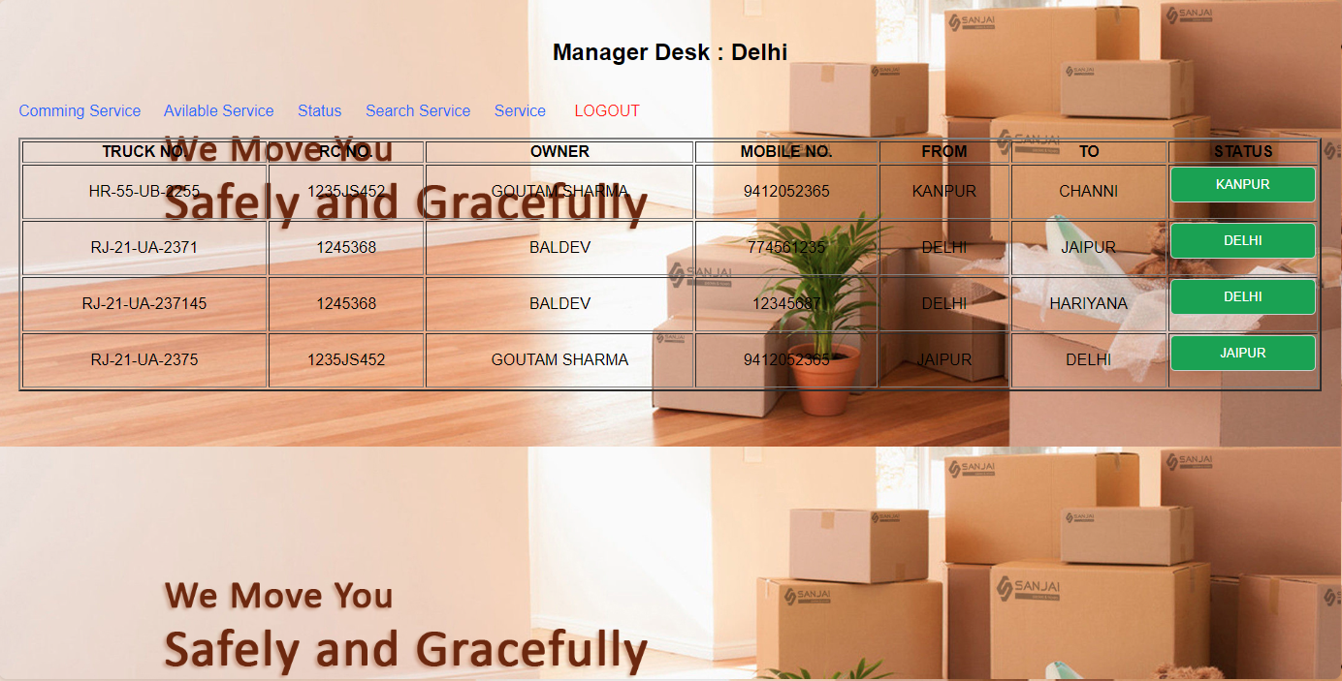
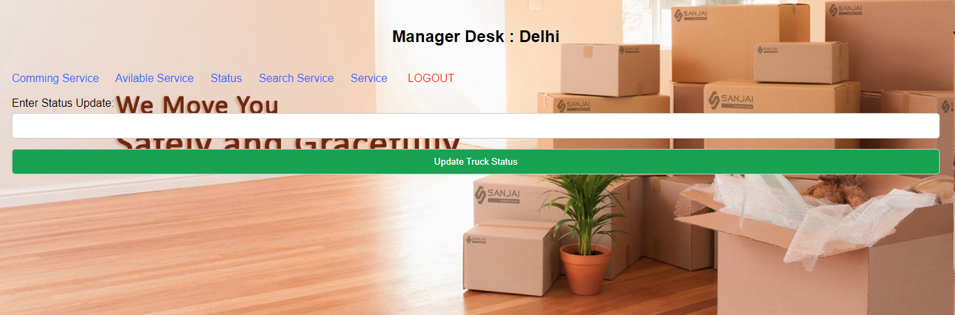
>When manager click on the Status then it can seen the all services as well as the current status of the vehicle and manager can Edit the status of the vehicle.
>When manage click on the Status Green button the arrow directed interface is created and manger can input the desire status of the vehicle is add and update using click on Update Truck status button

Slide 17
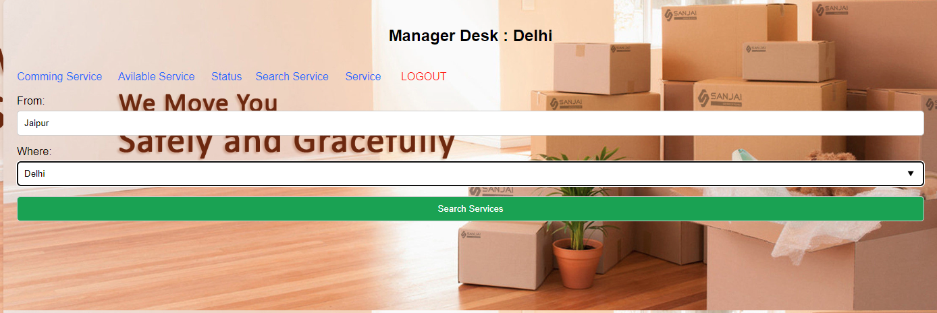
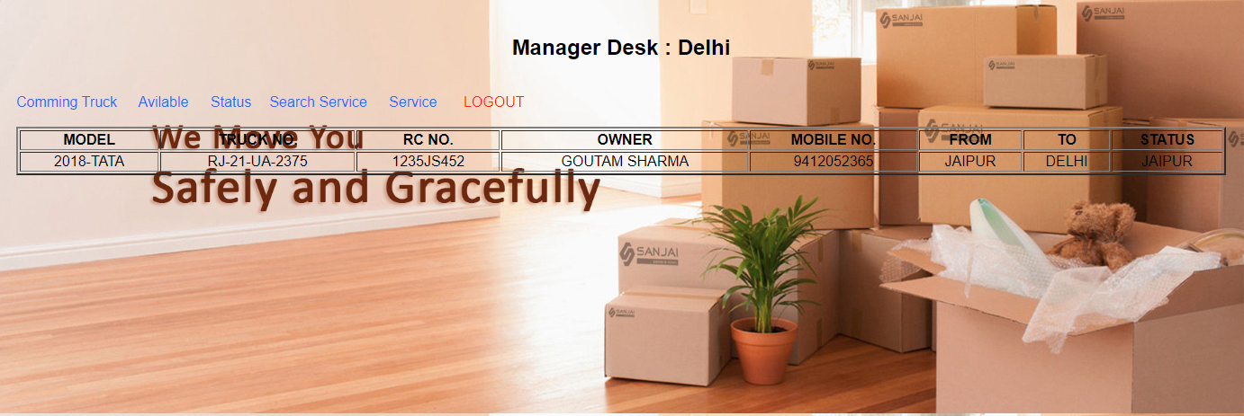
>When manager click on the Search Service then it can search the all services according to search input location.

Slide 18
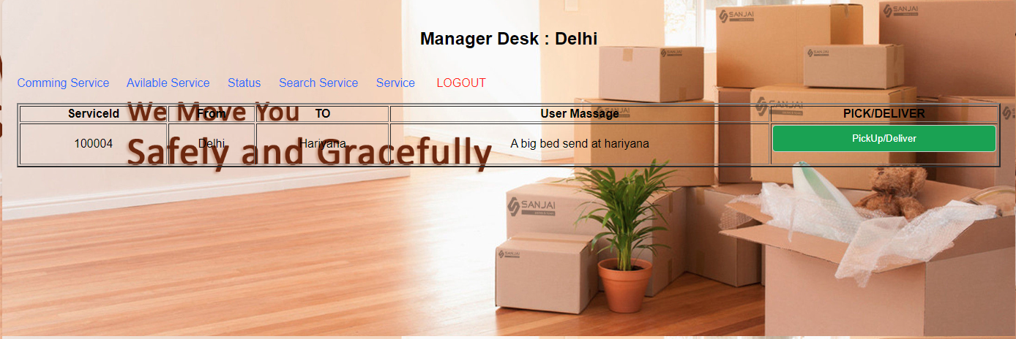
> When manager click on Service link then it can seen the all the user services which is verified by the company admin.
>Manager click on PickUp/Deliver button and take over the user service on the next level of delivery.
When Manager Press LOGOUT Link Home Page Seen

Slide 19
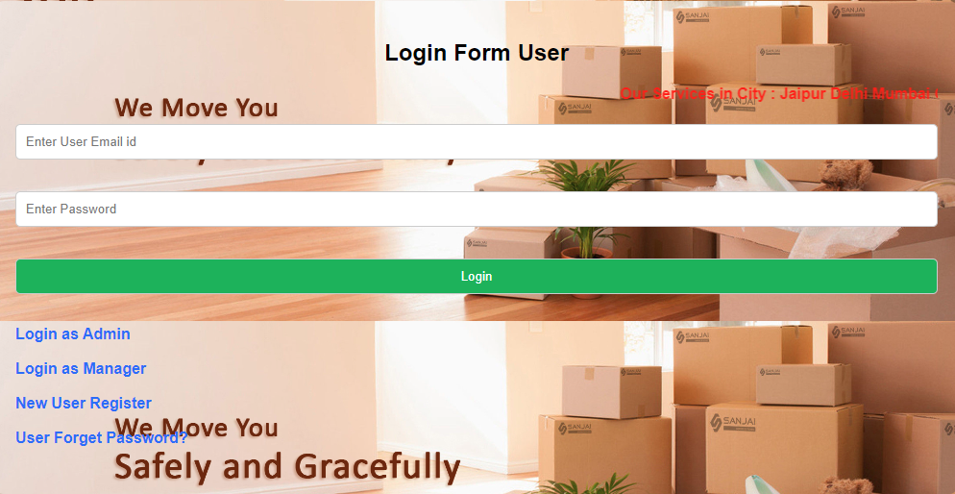
USER/CLIENT/CUSTOMER LAYER
New user register first in the company portal.
User can send the service request to company admin for delivery .
User can see his delivery service status .
User can Forget his password Using mail Id .
User can see the company services route .
User can see the regional offices and company contact .
User login interface

Slide 20
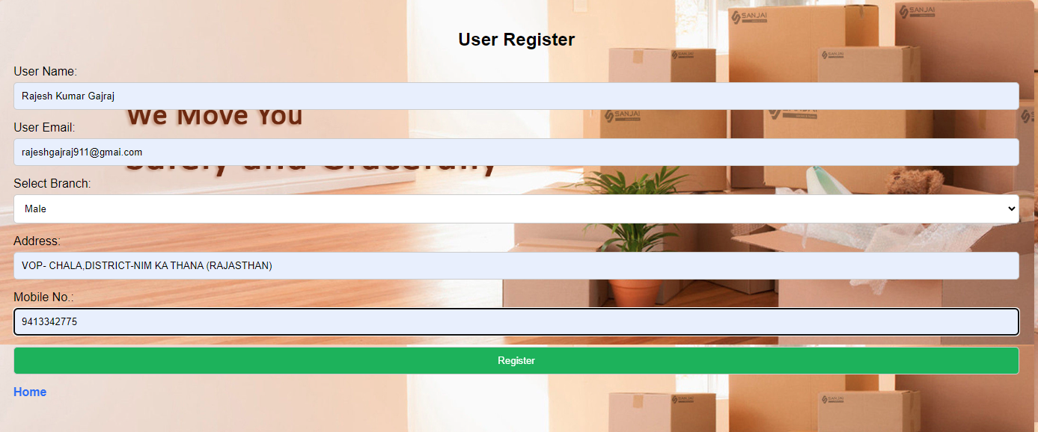
USER REGISTER INTERFACE
> When user fill the below interface field and click on the Register button then user register in company and User Id and Password send on the Email of the user.

Slide 21
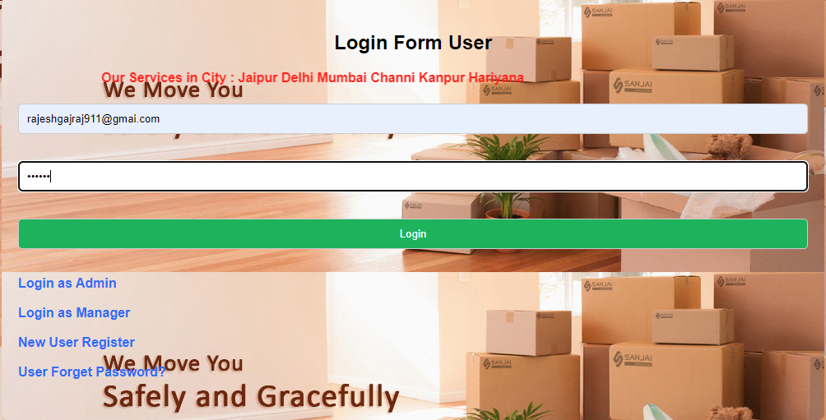

USER LOGIN INTERFACE
> When user fill the below interface field and click on the Login button then if user cradital is right then user login successfully otherwise user can’t be login.
Login

Slide 22
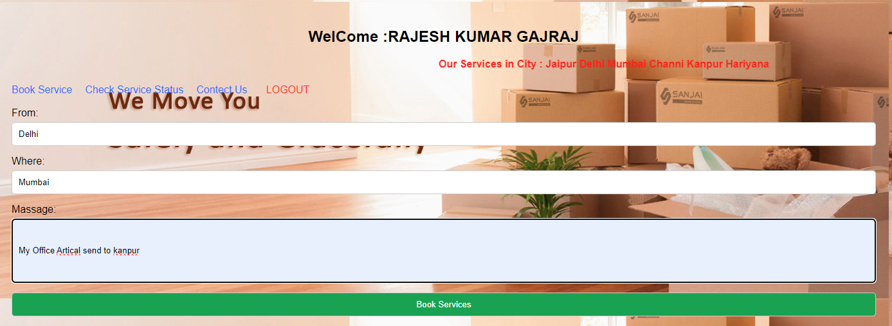
>when user click on the Book Service link then below interface in generate . using this interface and filling required field user can book service in company portal , that request show in the Admin interface and Admin can accept the request and decline also.

Slide 23
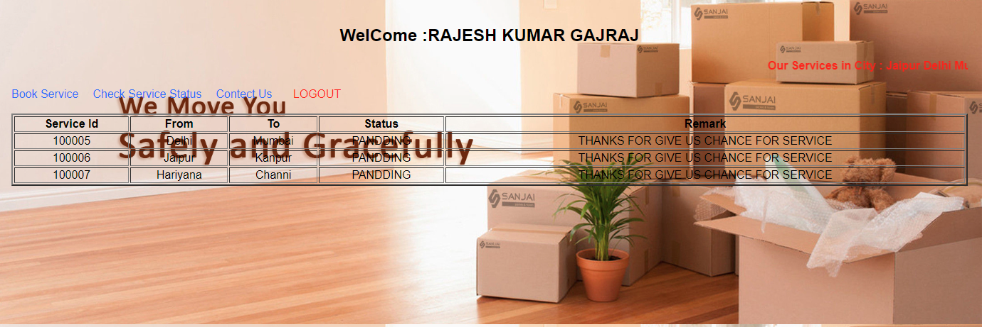
>When user click on the Check Service Status then user can seen the every service request with status.

Slide 24
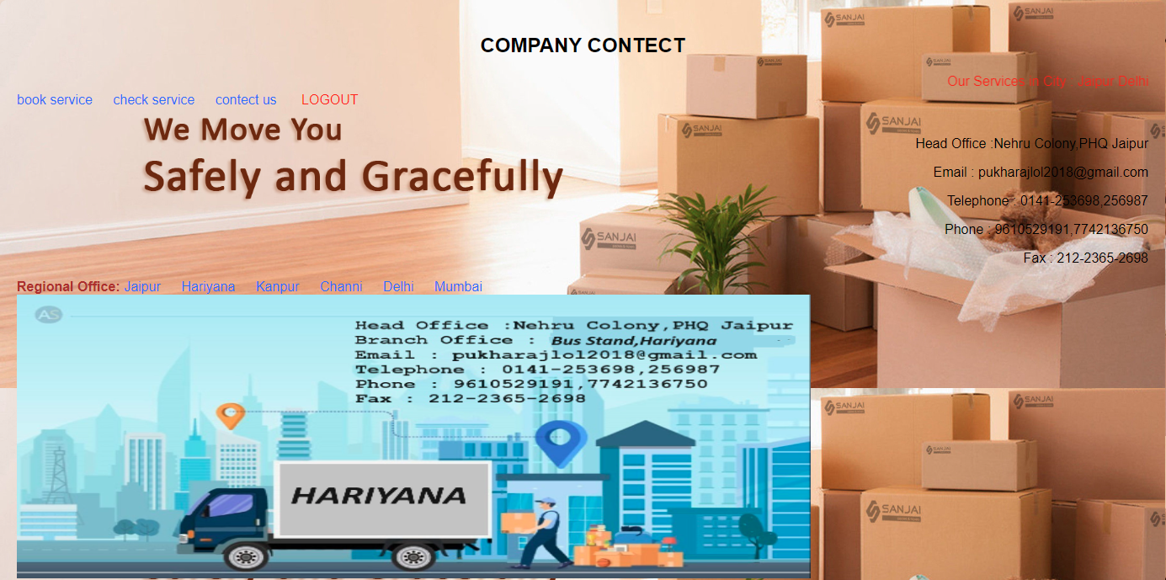
>When user click on the Contact Us then user can see the all company contact detail with regional offices.

Slide 25
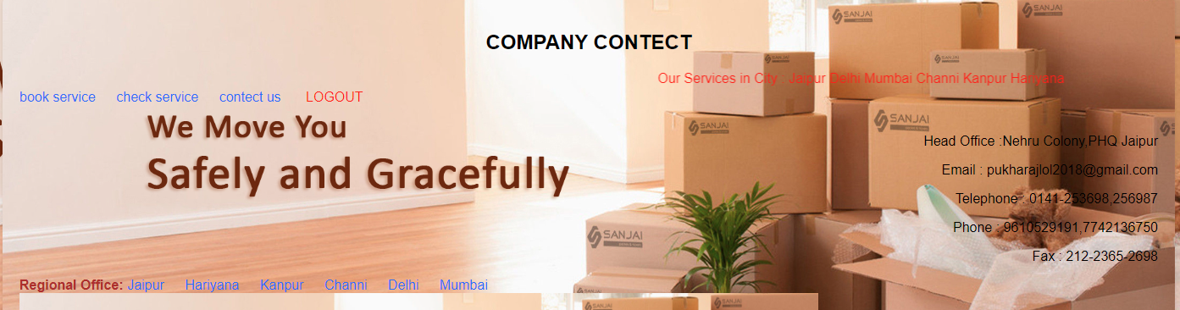
>When user click on the LOGOUT then user redirect on the Home page of company portal.
Home

Slide 26

THANKS FOR YOUR PRECIOUS TIME TO VISIT OUR
PORTAL PRESENTATION

